Slide 1
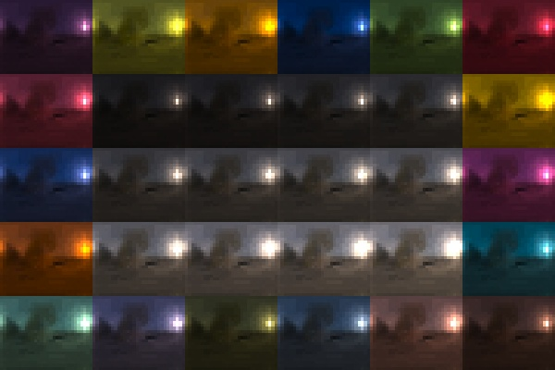
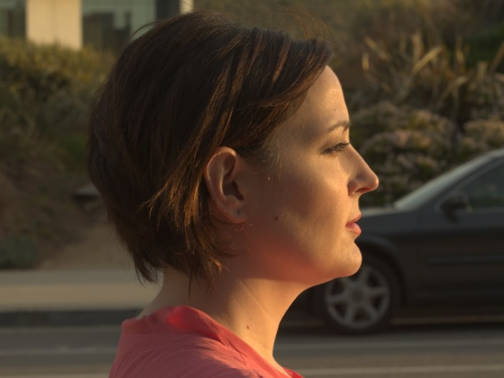
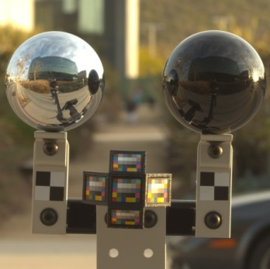
Practical Multispectral Lighting Reproduction
Chloe LeGendre Xueming Yu Dai Liu Jay Busch Andrew Jones
Sumanta Pattanaik¹ Paul Debevec
USC Institute for Creative Technologies University of Central Florida¹

Slide 2
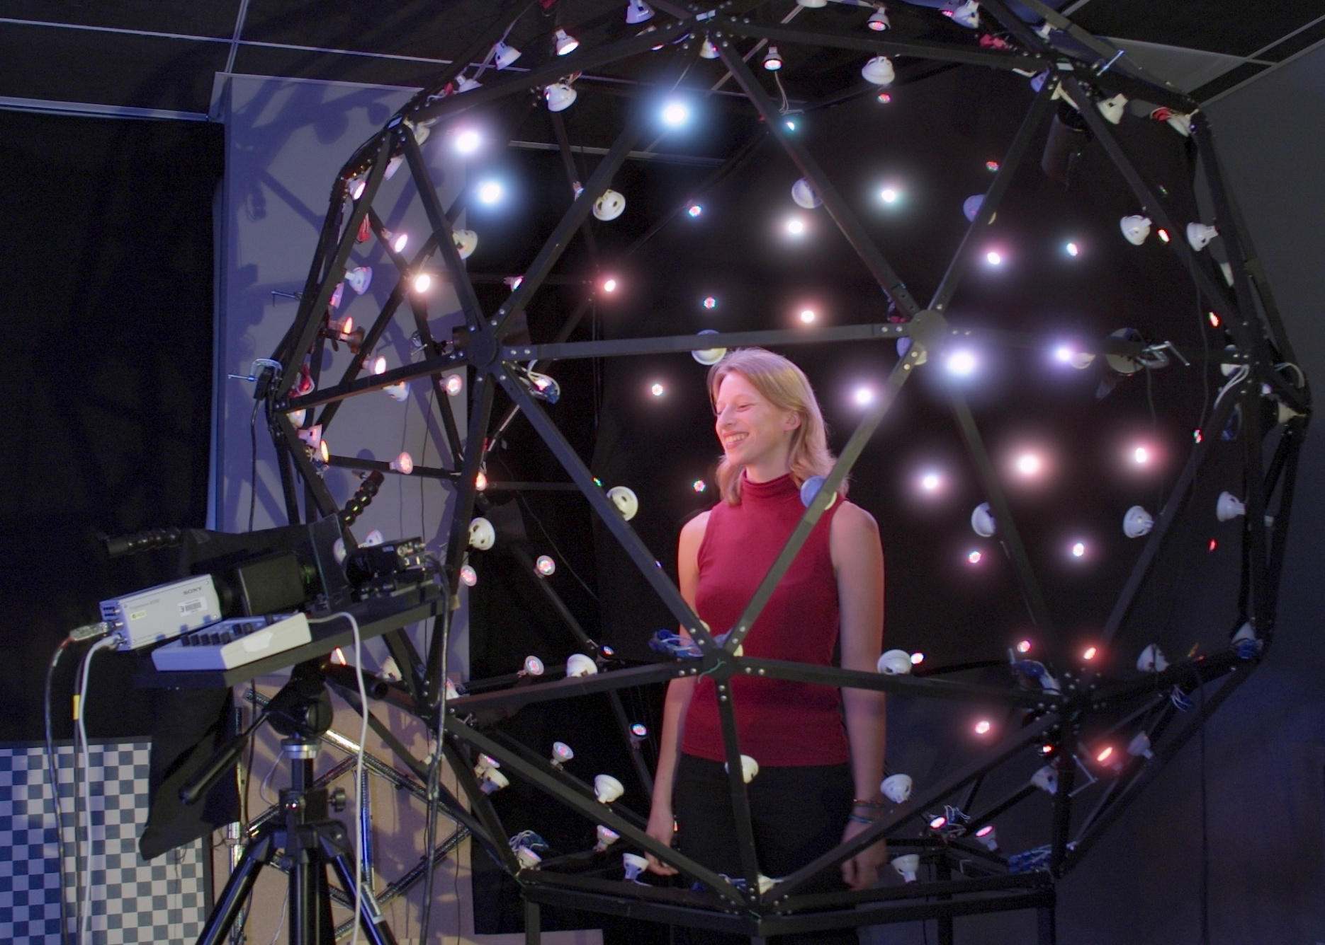
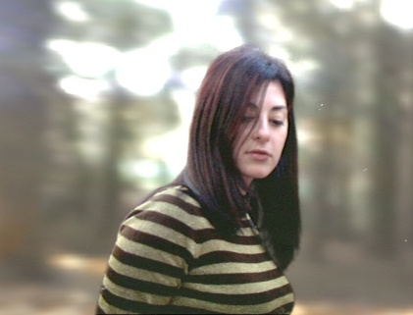
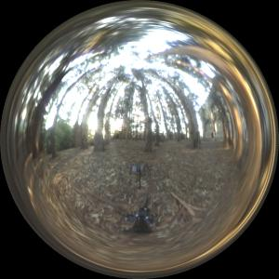
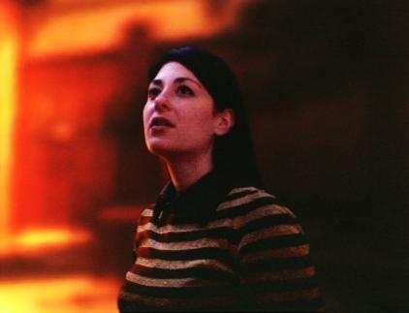
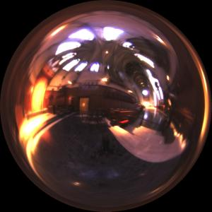
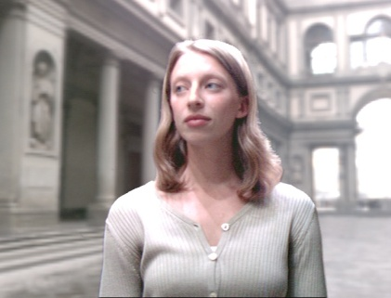
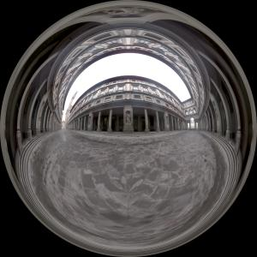
Lighting Reproduction
“A Lighting Reproduction Approach to Live-Action Compositing”
Debevec et al. [SIGGRAPH 2002]

Slide 3
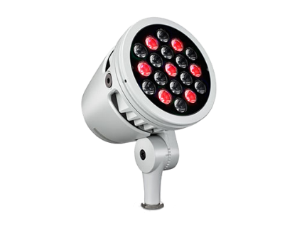
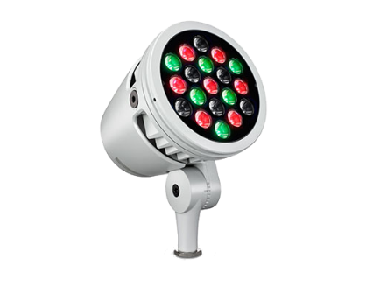
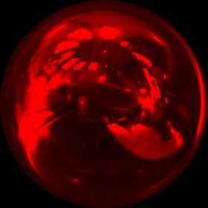
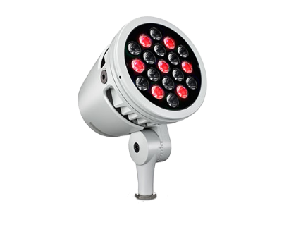
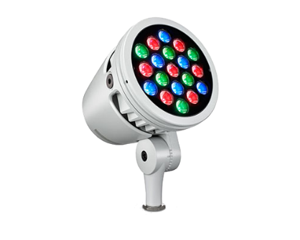
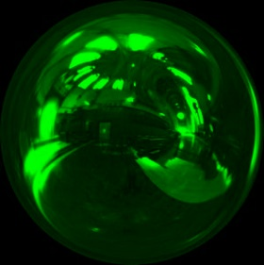
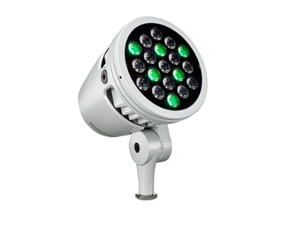
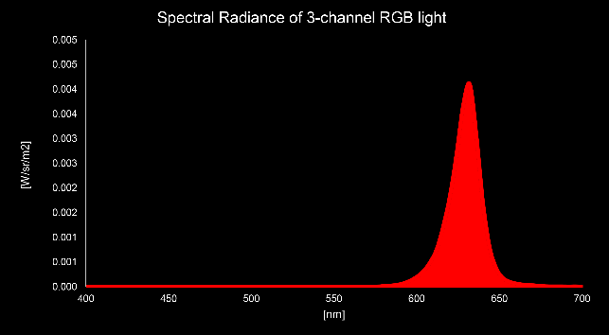
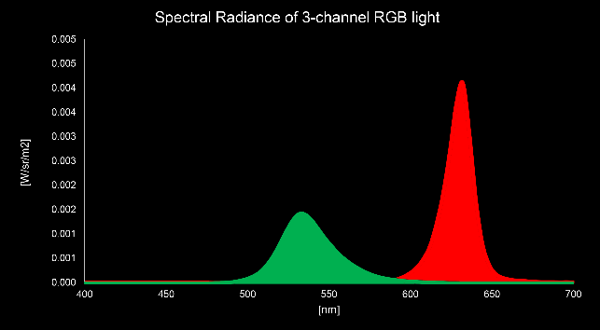
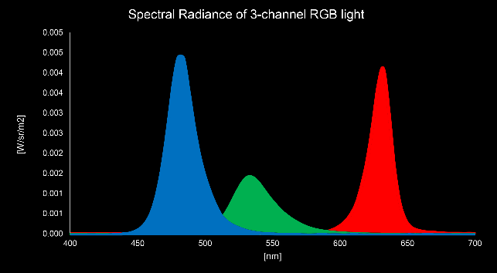
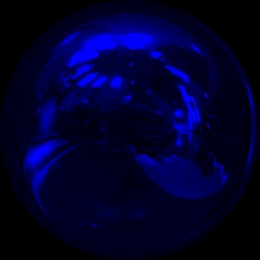
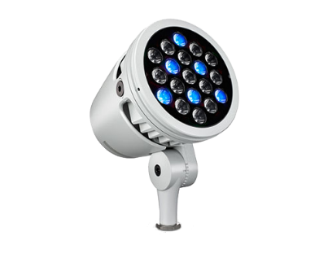
RGB Light Probes and RGB LEDs
RGB light probe
RGB LED spectra

Slide 4
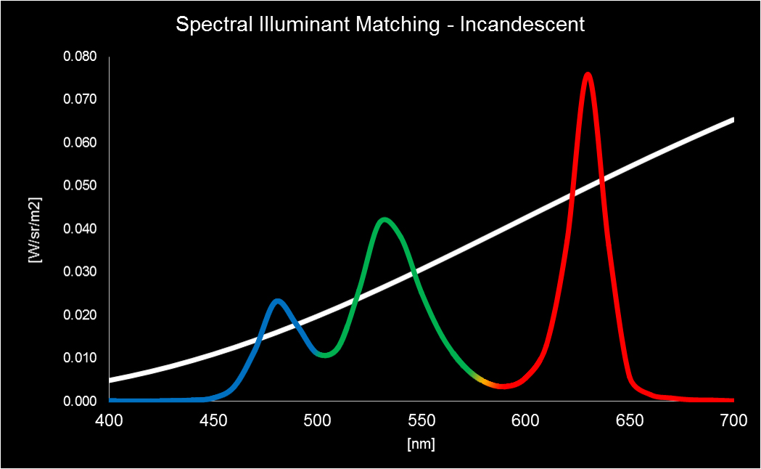
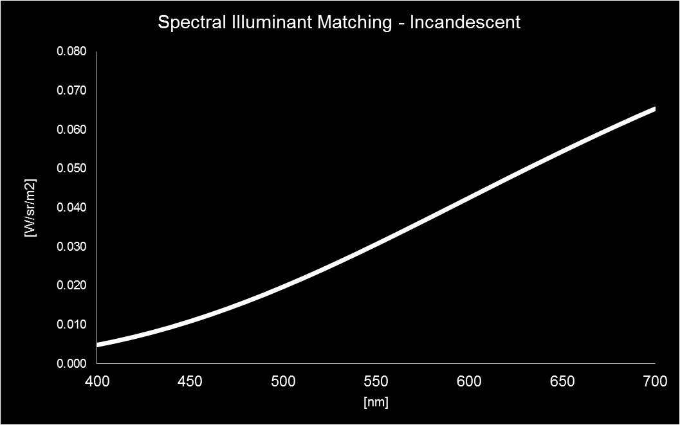
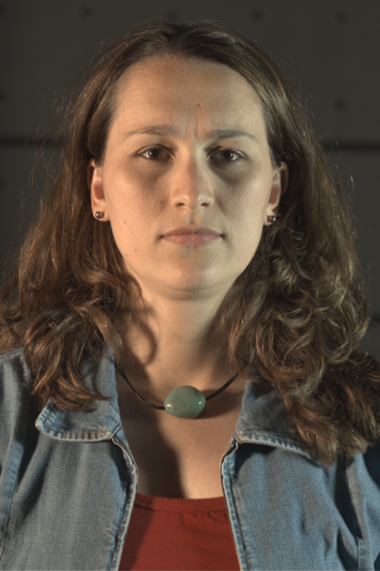
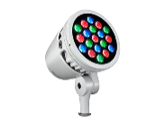
Matching Illumination Spectra with RGB LEDs
real lighting
LED lighting
“Optimizing Color Matching in a Lighting Reproduction System
for Complex Subject and Illuminant Spectra” Wenger et al. EGSR 2003

Slide 5
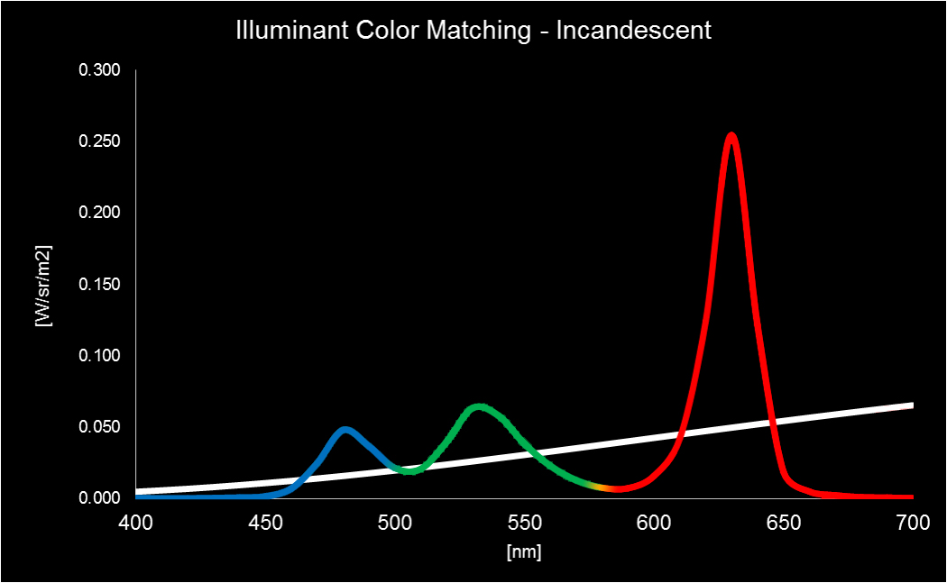
Matching Illumination Colors with RGB LEDs
real lighting
LED lighting
“Optimizing Color Matching in a Lighting Reproduction System
for Complex Subject and Illuminant Spectra” Wenger et al. EGSR 2003

Slide 6
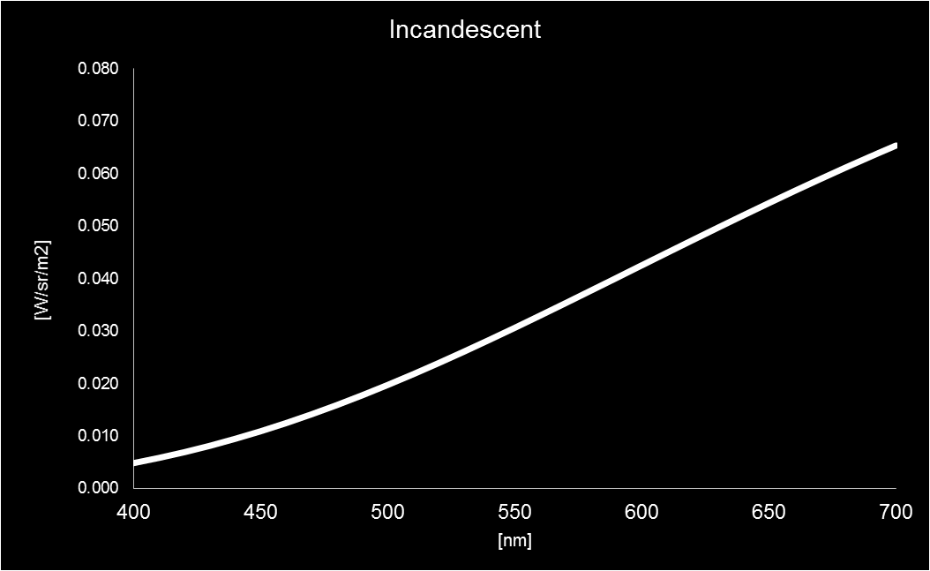
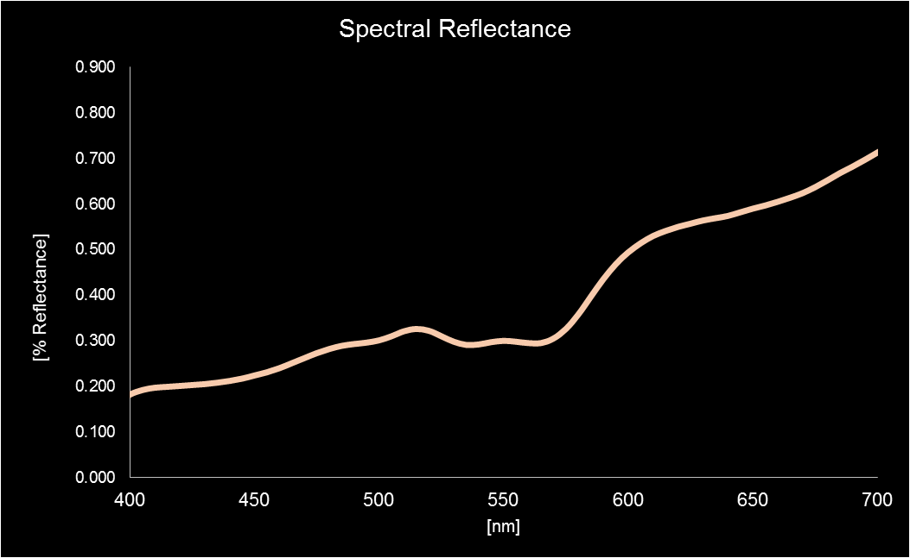
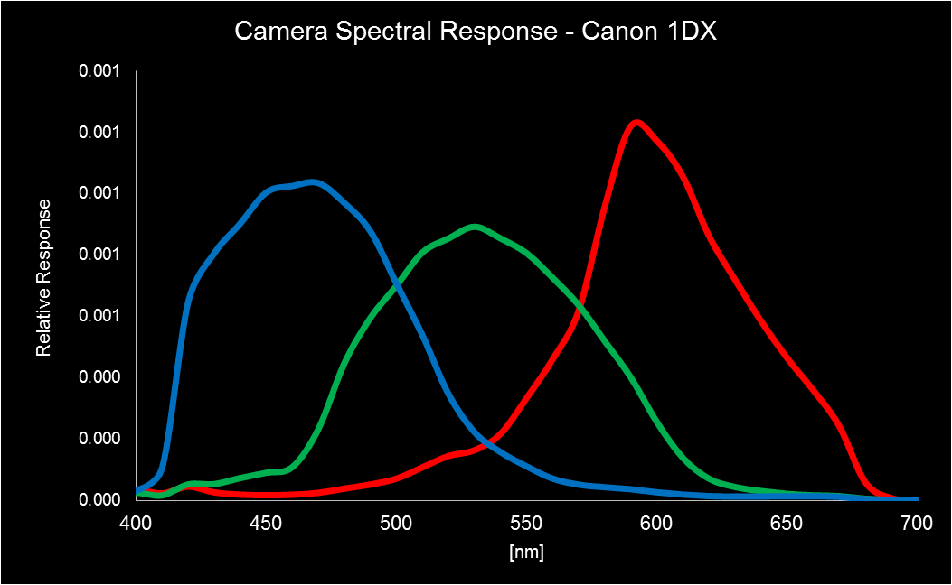
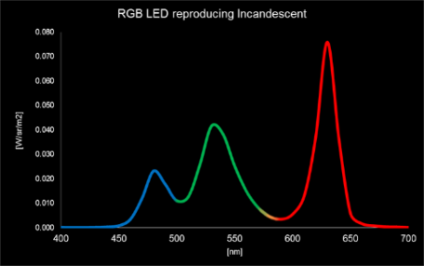
Pixel Values = Integral of modulated spectra
Illuminant
Material Reflectance
Camera Response
R
GB
(skin)
=
(
*
*
)
=
LED Spectral Match
(skin)
≠
(
)
=
*
*

Slide 7
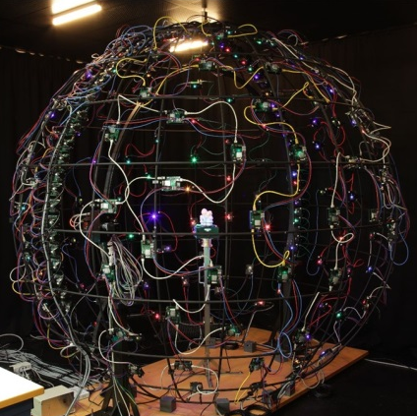
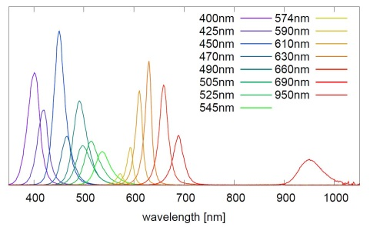
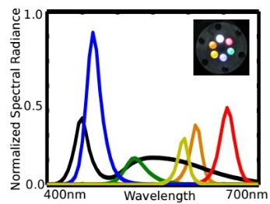
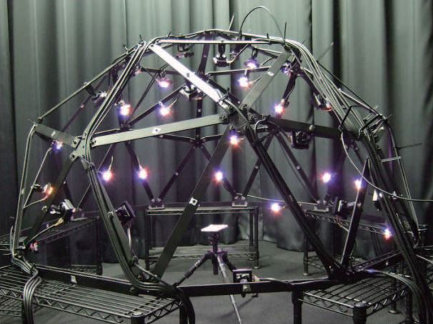
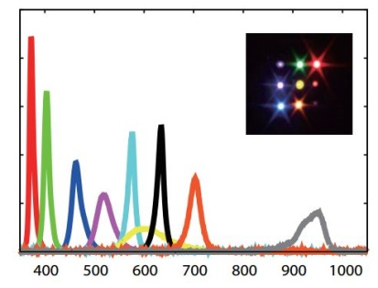
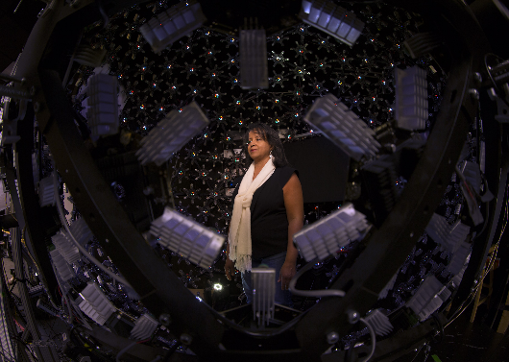
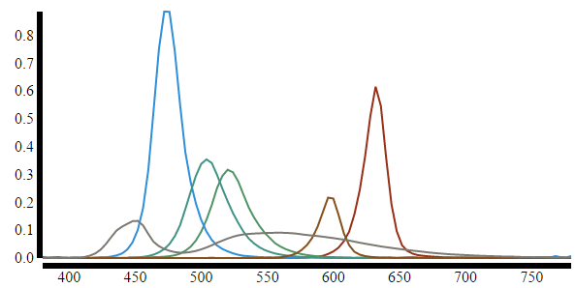
Multispectral Light Stages
16 LED spectra
6 LED spectra
Adjin et al. [2012]
Gu and Liu [CVPR 2012]
6 LED spectra
9 LED spectra
Kitahara et al. [VISAPP 2014]
Ours [SIGGRAPH 2016]

Slide 8
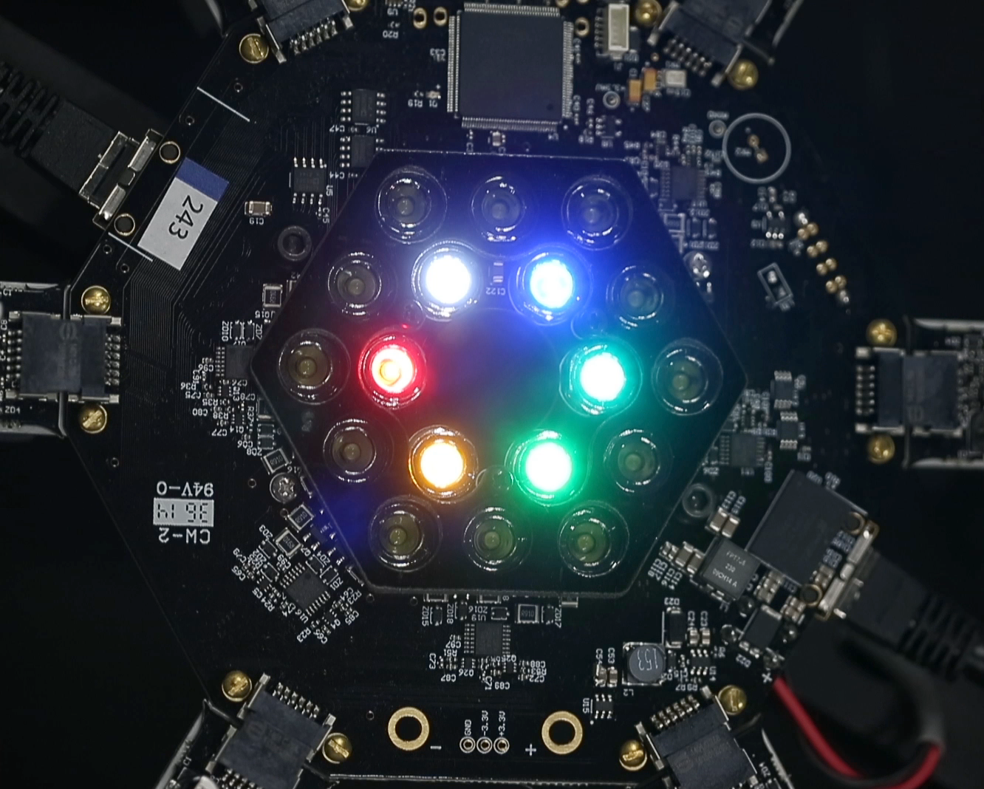
How does one drive multispectral lights to replicate real-world lighting?
?
RGB
RGBCAW

Slide 9
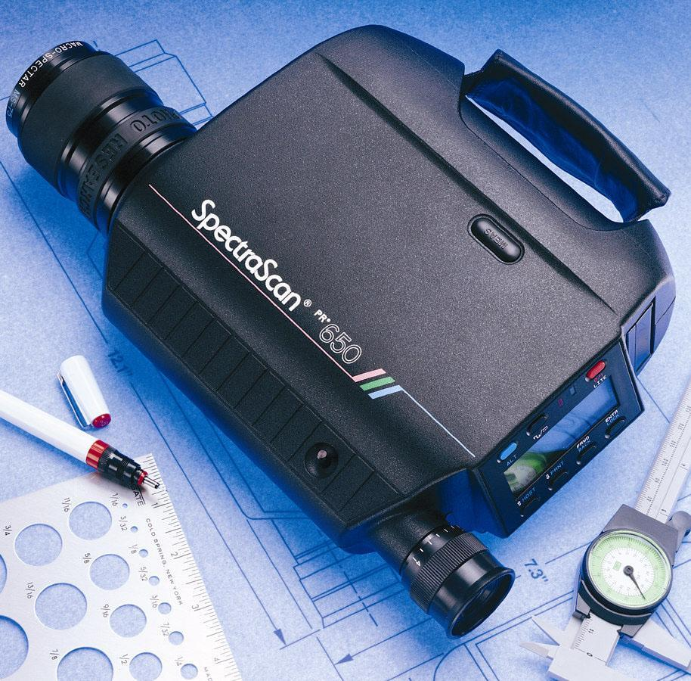
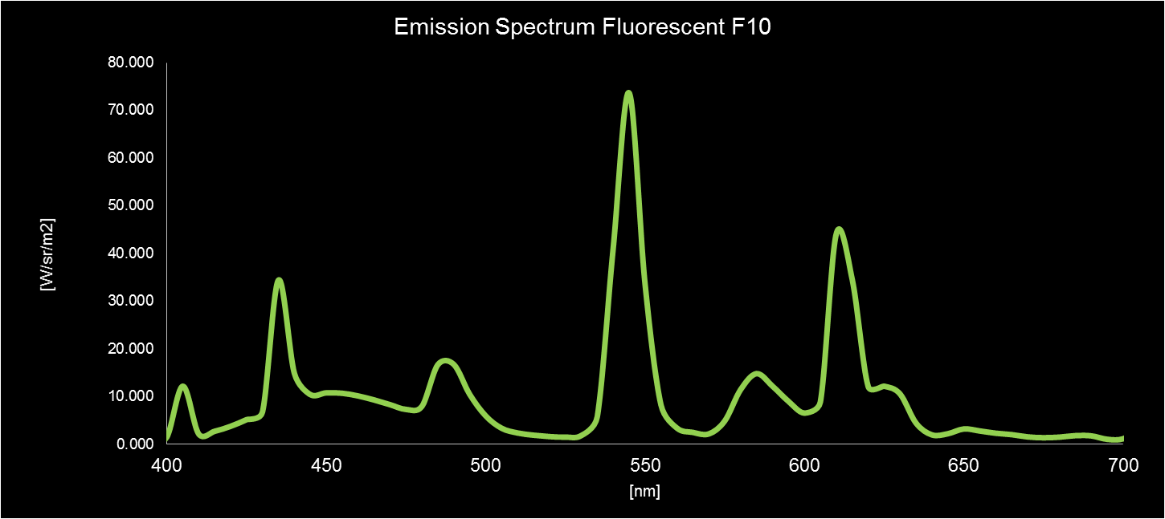
A Straightforward Approach
Measure illumination spectrum from
every direction with spectroradiometer
Mix the LEDs to match the measured spectrum

Slide 10
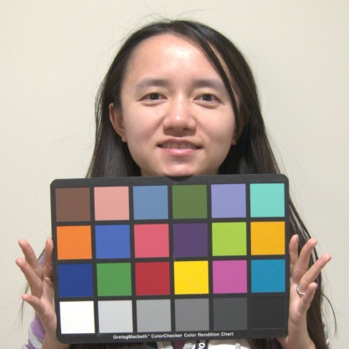
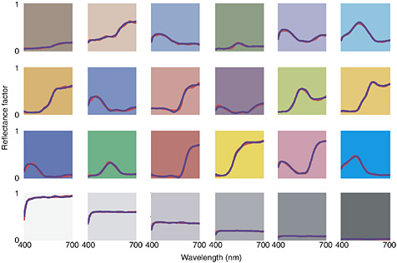
The ColorChecker™ Chart
“A Color Rendition Chart.” McCamy et al. [Journal of Applied Photographic Engineering 1976].
“Illuminant spectrum estimation using a digital color camera and a color chart.” Shi et al. [SPIE 2014].

Slide 11
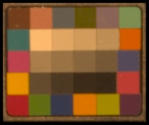
Matching A Color Chart with Multispectral LEDs
α_{R} ∙
+
+
α_{G} ∙
α_{B} ∙
red
green
blue
≈
+
+
+
α_{C} ∙
α_{A} ∙
α_{W} ∙
color chart
lit by tungsten
cyan
amber
white

Slide 12
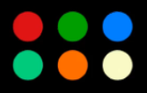
Matching A Color Chart with Multispectral LEDs
RGBCAW
avg. error < 2%
RGBW
RGB
RGBCAW
RGBW
RGB

Slide 13
Matching A Color Chart with Multispectral LEDs
RGBCAW
avg. error < 2%
RGBW
RGB

Slide 14
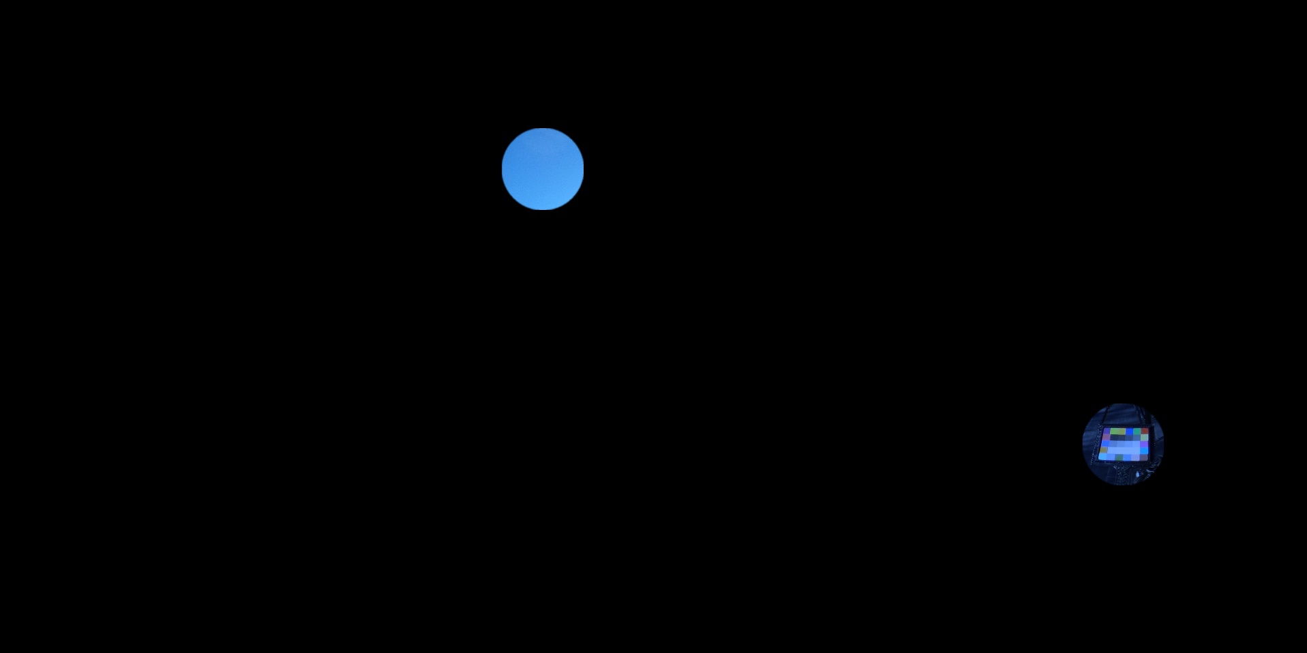
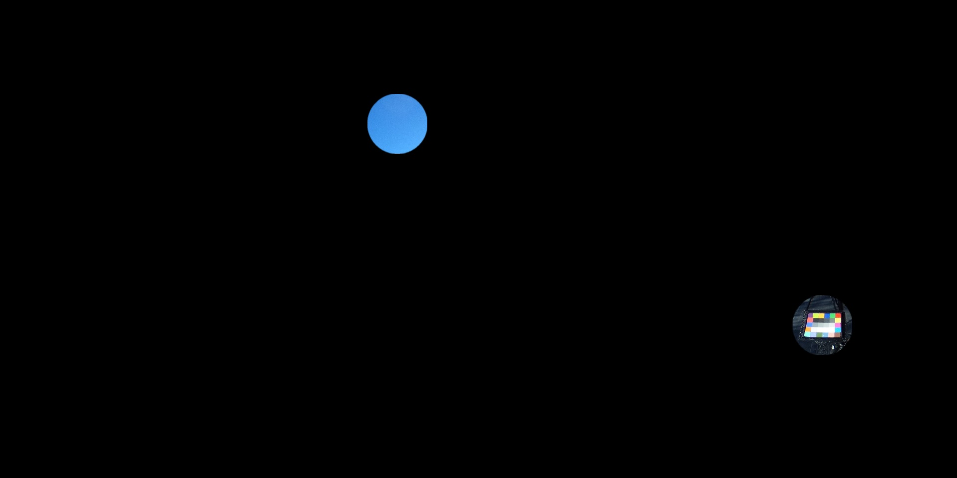
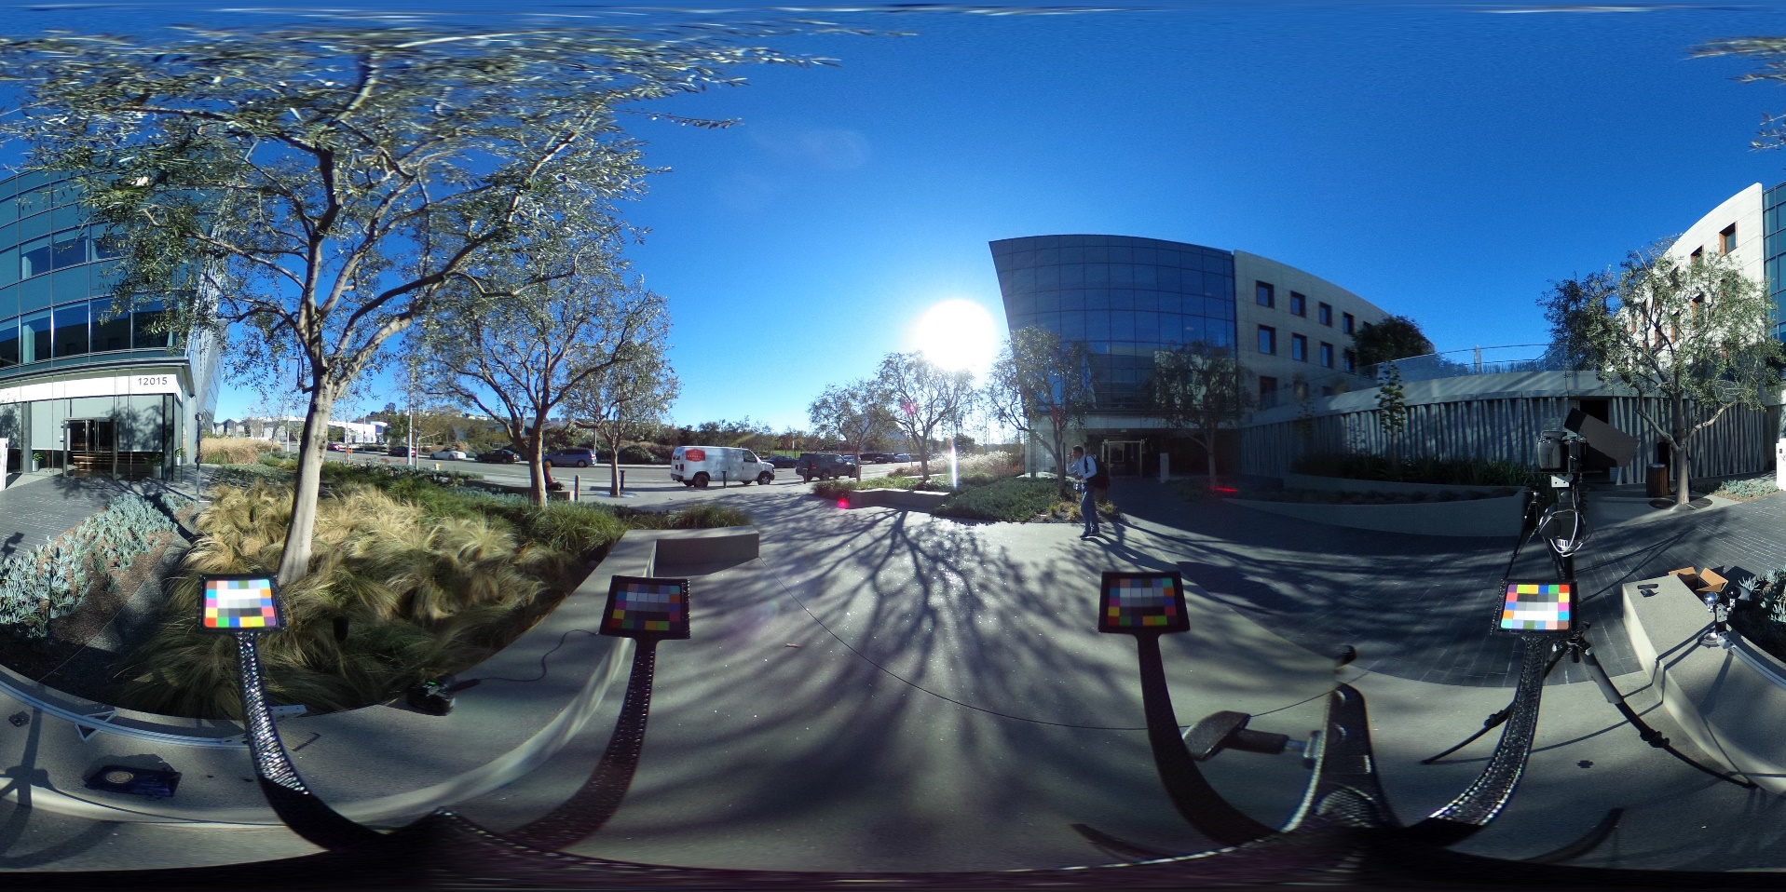
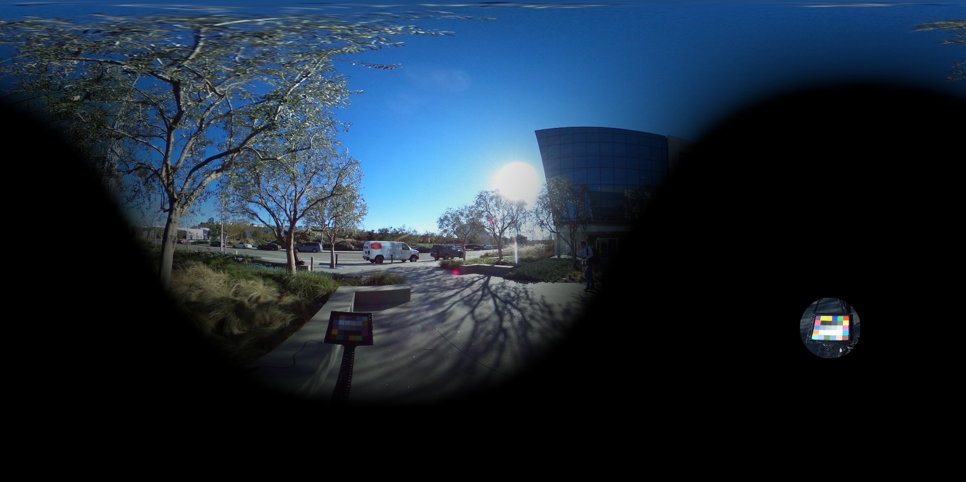
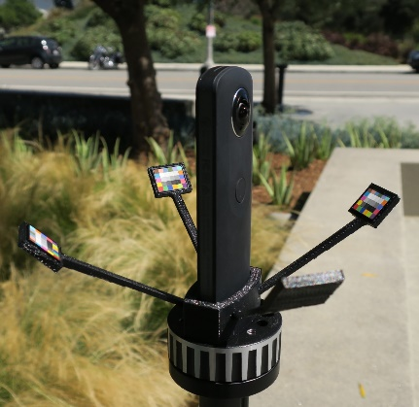
A Color Chart Integrating a Hemisphere of Light
ColorChecker Nano Matte Finish (Edmund Optics)

Slide 15
Exposing a color chart to a narrow cone of light
10° diffuser
ColorChecker Pico Matte Finish (Edmund Optics)

Slide 16
Exposing a color chart to narrow cones of light

Slide 17
Recording an Omnidirectional Color Chart Panorama

Slide 18
Recording an Omnidirectional Color Chart Panorama
original sampled color charts
EXIF shutter speed map
HDR color chart panorama

Slide 19
Lighting a Subject with a Color Chart Panorama
subject in light stage
color chart panorama
real photo
light stage

Slide 20
Fast Multispectral Lighting Environment Capture
HDR Capture Time 1.5 seconds

Slide 21
Fast Multispectral Lighting Environment Capture
unwrapped lat-long mirror ball
original probe
sparse color charts
unwrapped lat-long black ball

Slide 22
Desired dataset: color chart appearance for every direction

Slide 23
What we have: color chart appearance for five directions

Slide 24
Color charts interpolated/extrapolated to all directions, but low resolution

Slide 25
RGB HDRI map tells us the white square color everywhere

Slide 26
Combined map produces chart estimates for all directions, consistent with both RGB HDRI maps and 5 chart observations

Slide 27
Lighting Reproduction Results
lighting capture
real photo
light stage
avg. error < 2%

Slide 28
Relighting Results: Indoor
lighting capture
real environment
light stage
light stage
light stage

Slide 29
Relighting Results: Outdoor
lighting capture
real environment
light stage
light stage
light stage

Slide 30
Compositing Results
real environment
background
light stage
flash matte
lighting capture

Slide 31
REAL PHOTO

Slide 32
LIGHT STAGE
COMPOSITE

Slide 33
REAL PHOTO

Slide 34
LIGHT STAGE
COMPOSITE

Slide 35
REAL PHOTO

Slide 36
LIGHT STAGE
COMPOSITE

Slide 37
REAL PHOTO

Slide 38
LIGHT STAGE
COMPOSITE

Slide 39
Dynamic Multispectral Lighting Reproduction
Greg video

Slide 40
Key Takeaways
No spectral measurements!
Color error minimized directly, so results should be optimal
∑
≈
Lighting capture as fast as traditional light probe photography
RGBCAW yields close matches for many environments materials
Even RGBW may be sufficient for some applications
COMPOSITE

Slide 41
Optimal LED Selection
for Multispectral Lighting Reproduction
Poster Session
Thanks
Thanks: Randy Hill, Clarke Lethin, Kathleen Haase, Christina Trejo, Greg Downing, Jamison Moore, Mark Bolas, Jessica Robertson, Jonetta Thomas, Donna Ruffin, Dan Sherlock, Joe di Gennaro, Keith Snail, Kathryn Rock, Darren Hendler, Digital Domain, Graham Fyffe, Koki Nagano, Shanhe Wang, Loc Huynh
Research Sponsors: Army Research Lab, STTC, US Army RDECOM, Natick Soldier Systems Center, USC Office of the Provost, Qualcomm, USC Annenberg Fellowship
http://gl.ict.usc.edu/ legendre@ict.usc.edu

